Slide 1
Treatment of Multisystem Inflammatory Syndrome in Children
1st July 2021, NEJM
KPC Medical College & Hospital
Dr Sayonee Das
PG Resident
Department of Medicine
KPC Medical College & Hospital
Kolkata

Slide 2
Clinical Questions
What is multisystem inflammatory syndrome (MIS-C)
Why is it being discussed and what is its relevance
How to deal with it

Slide 3
Initial Reports
A temporal association between SARS-CoV-2 and MIS-C (in children) first noted in April 2020.
A rare but serious complication.
MIS-C occurs 2 to 6 weeks after SARS-CoV-2 infection.

Slide 4
MIS-C Clinical Features
Persistent fever
Nonspecific symptoms : abdominal pain, vomiting, headache, and fatigue.
Conjunctival injection (hyperemia) and rash resembling Kawasaki’s disease.
Severely affected children have multiorgan failure and shock that requires inotropic support.

Slide 5
Investigations
Elevated levels of :
C-reactive protein
Ferritin
Troponin
N-terminal pro–B-type natriuretic peptide
Reduced levels of:
Hemoglobin
Platelets
Lymphocytes

Slide 6
Resemblance
Kawasaki’s disease
Macrophage activation syndrome
Staphylococcal toxic shock syndrome

Slide 8
Mechanism

Slide 9
Multisystem Inflammatory Syndrome (MIS-C) VS Kawasaki disease
MIS-C | KAWASAKI DSEASE
Mean age 10-11 y | Mean age 2 y
Individuals with African heritage appear at highest risk | Asians at highest risk
Severe abdominal pain | Less severe GI complaints
Myocardial dysfunction/myocarditis | Coronary artery abnormalities (25%-60% in Kawasaki shock syndrome)
Acute kidney injury | Renal involvement very rare
NT-pro-BNP and troponin ↑↑ | Not often reported (myocardial dysfunction less severe) but generally normal to mildly increased
Ferritin, triglycerides, and CRP ↑↑ | Same. but less severe
Platelet count ↓ and normalizes with recovery | Marked thrombocytosis by day 10-14
Lymphopenia | Lymphopenia not described
Association with SARS -CoV2 infection (2-4 week prior) | Specific etiology still unknown; no association with SARS COV2

Slide 10
Preliminary WHO case definition
Children and adolescents 0–19 years of age with fever >3 days
AND
Two of the following:
Rash or bilateral non-purulent conjunctivitis or muco-cutaneous inflammation signs (oral, hands or feet)
Hypotension or shock
Features of myocardial dysfunction, pericarditis, valvulitis, or coronary abnormalities (including ECHO findings or elevated Troponin/NT-pro BNP)
Evidence of coagulopathy (by PT, PTT, elevated d-Dimers)
5. Acute gastrointestinal problems (diarrhea, vomiting, or abdominal pain)
AND
Elevated markers of inflammation such as ESR, C-reactive protein, or procalcitonin
AND
No other obvious microbial cause of inflammation, including bacterial sepsis, staphylococcal or streptococcal shock syndromes
AND
Evidence of COVID-19 (RT-PCR, antigen test or serology positive), or likely contact with patients with COVID-19

Slide 11
Treatment
Supportive measures have included:
Fluid resuscitation;
Inotropic support;
Respiratory support; and
In rare cases, extracorporeal membranous oxygenation (ECMO).
Anti-inflammatory measures includes frequent use of IVIG and steroids.
Anti-coagulation treatments with Aspirin.
Antibiotics are routinely used to treat potential sepsis while awaiting bacterial cultures.
The role of SARS-CoV-2 antiviral therapies (eg, remdesivir) in the management of MIS-C is uncertain.
Thrombotic prophylaxis is often used given the hypercoagulable state typically associated with MIS-C.

Slide 13
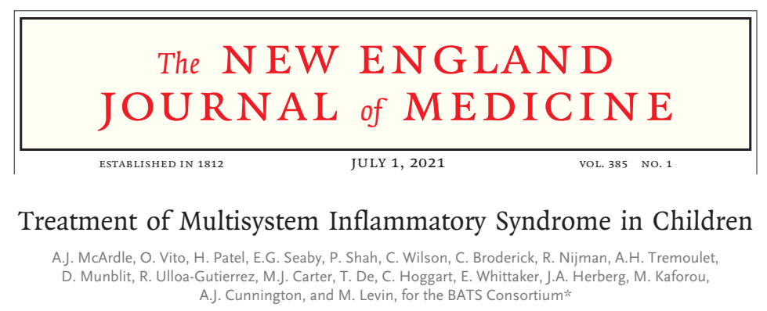
Andrew J. McArdle, M.B., B.Chir., Ortensia Vito, M.Sc., Harsita Patel, M.B., B.S., Eleanor G. Seaby, B.M., B.S., Priyen Shah, M.B., B.S.,
Clare Wilson, M.B., B.Chir., Claire Broderick, M.B., B.S., Ruud Nijman, M.D., Ph.D., Adriana H. Tremoulet, M.D., Daniel Munblit, M.D., Ph.D.,
Rolando Ulloa-Gutierrez, M.D., Michael J. Carter, B.M., B.Ch., D.Phil., for the BATS Consortium*
NEJM JULY 1 2021

Slide 14
Background
Evidence is urgently needed to support treatment decisions for children with multisystem inflammatory syndrome (MIS-C) associated with severe acute respiratory syndrome coronavirus 2.

Slide 15
Methods
International observational cohort study of clinical and outcome data regarding suspected MIS-C that had been uploaded by physicians onto a Web-based database.
Inverse-probability weighting and generalized linear models were used to evaluate intravenous immune globulin (IVIG) as a reference, as compared with IVIG plus glucocorticoids and glucocorticoids alone.

Slide 16
Outcome measures
There were two primary outcomes: the first was a composite of inotropic support or mechanical ventilation by day 2 or later or death; the second was a reduction in disease severity on an ordinal scale by day 2.
Secondary outcomes included treatment escalation and the time until a reduction in organ failure and inflammation.

Slide 17
Statistical analysis
Weighted logistic-regression methods: to analyze dichotomous outcomes
Weighted Cox regression methods: time-to-event analyses
Outcomes were reported as odds ratios or average hazard ratios with 95% confidence intervals, using IVIG alone as the reference category.
Inflammatory markers were plotted as percentages of each patient’s peak value.

Slide 18
Case Material
From June 20, 2020, to February 24, 2021.
81 hospitals in 34 countries uploaded data.
651 patients with suspected MIS-C to the study database.
614 children from 32 countries met the inclusion criteria.

Slide 19
Primary Therapy Groups

Slide 20
Treatments during First 5 Days of Hospitalization

Slide 22
Primary outcomes
The results for the two primary outcomes showed an acceptable degree of balance with respect to the covariates.

Slide 23
Secondary outcomes
Escalation of immunomodulatory treatment was less common among the patients who received IVIG plus glucocorticoids than among those who received IVIG alone.
The comparison was inconclusive between the patients who received glucocorticoids alone and those who received IVIG alone.
No clear between-group differences were seen in blood markers, inotropic support, or mechanical ventilation between patients who had an escalation to other treatments by day 2 and those who continued to receive the initial treatment .

Slide 24
Comparison of IVIG plus Glucocorticoids versus IVIG Alone
IVIG plus Glucocorticoids
IVIG alone

Slide 25
Comparison of Glucocorticoids Alone versus IVIG Alone
Glucocorticoids
IVIG

Slide 26
Effect of immunomodulation on blood markers
Levels of C-reactive protein decreased more rapidly in patients who received immunomodulators than in those who did not receive such treatment.
Changes in levels of C-reactive protein, troponin, and ferritin followed a similar temporal decrease in the three groups.

Slide 27
Changes in Levels of C-Reactive Protein, Troponin, and Ferritin, According to Type of Treatment and Timing

Slide 28
Changes in Levels of C-Reactive Protein, Troponin, and Ferritin, According to Type of Treatment and Timing

Slide 29
Changes in Levels of C-Reactive Protein, Troponin, and Ferritin, According to Type of Treatment and Timing

Slide 31
Conclusions
There was no evidence of substantial differences in the two primary outcomes among children who received the three most common treatments for this disorder (IVIG alone, IVIG plus glucocorticoids, and glucocorticoids alone).
However, when the analyses was restricted to patients who met the WHO criteria for MIS-C, modest evidence of benefit was found with glucocorticoids alone over IVIG alone for both primary outcomes.

Slide 32
Strengths of the study
Large
International
Multi-centre
Cohort trial

Slide 33
Weaknesses of the study
Available statistical information regarding the frequencies of different clinical features may be skewed by selection bias.
Higher rates of treatment escalation in single-agent groups may have masked differences in efficacy.
IVIG and biologic agents are costly and have limited availability.
The study does not provide conclusive evidence for either equivalence or superiority of any of the three treatments.

Slide 34
There has been uncertainty as to whether the condition is confined to children, and the appropriateness of excluding adults from case definitions is questionable.
Sporadic reports exist of a similar life-threatening condition, denominated 'multisystem inflammatory syndrome in adults' (MIS-A), which also usually requires intensive care.

Slide 35
In June, an adult case of a Kawasaki-like multisystem inflammatory syndrome following SARS-CoV-2 infection was described in a 54-year-old woman from Israel with no history of autoimmune disease, who experienced uveitis in both eyes.

Slide 36
A case involving a 36-year-old Hispanic American woman with clinical features otherwise consistent with MIS-C was reported from New York.

Slide 37
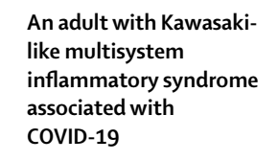
Lancet . 2020 Jul 25;396(10246):e8-e10
A case report published in The Lancet regarding a 45-year-old Hispanic man who presented in New York with features strongly resembling MIS-C called for awareness of "a potential MIS-C-like condition in adults."

Slide 38
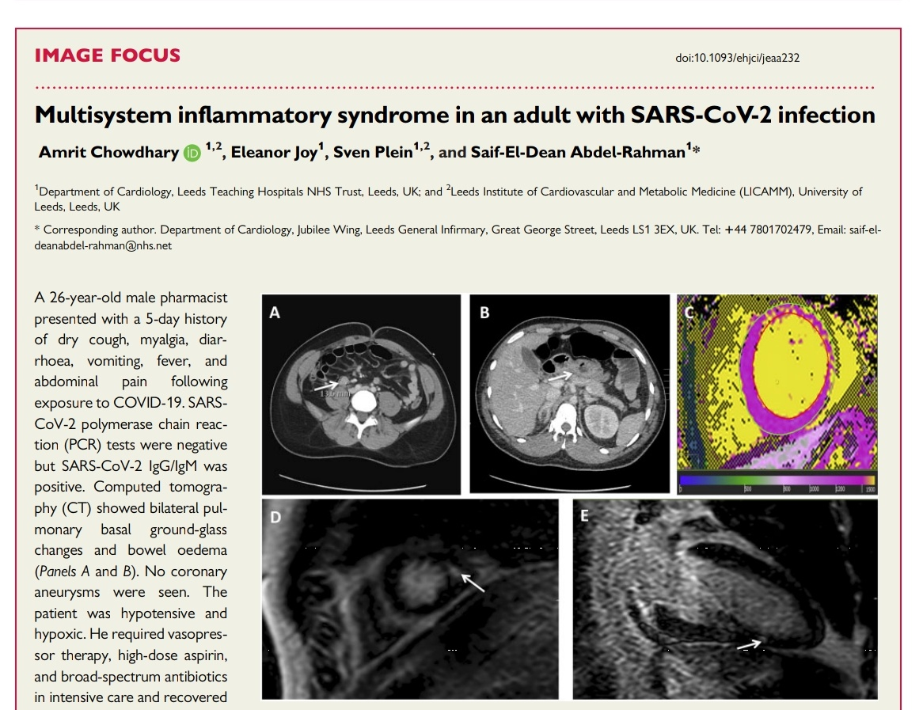
Further reports of multisystem inflammatory syndrome linked to COVID-19 exposure emerged in adults.

Slide 39
THANK YOU

